Slide 1
Credit Card Fraud Detection.
Classification project

Slide 2
Description:
161
It is important that credit card companies are able to recognize fraudulent credit card transactions so that customers are not charged for items that they did not purchase.
Dataset:
This dataset presents transactions that occurred in two days, where we have 161 frauds out of 100,000 transactions. The dataset is highly unbalanced.

Slide 3
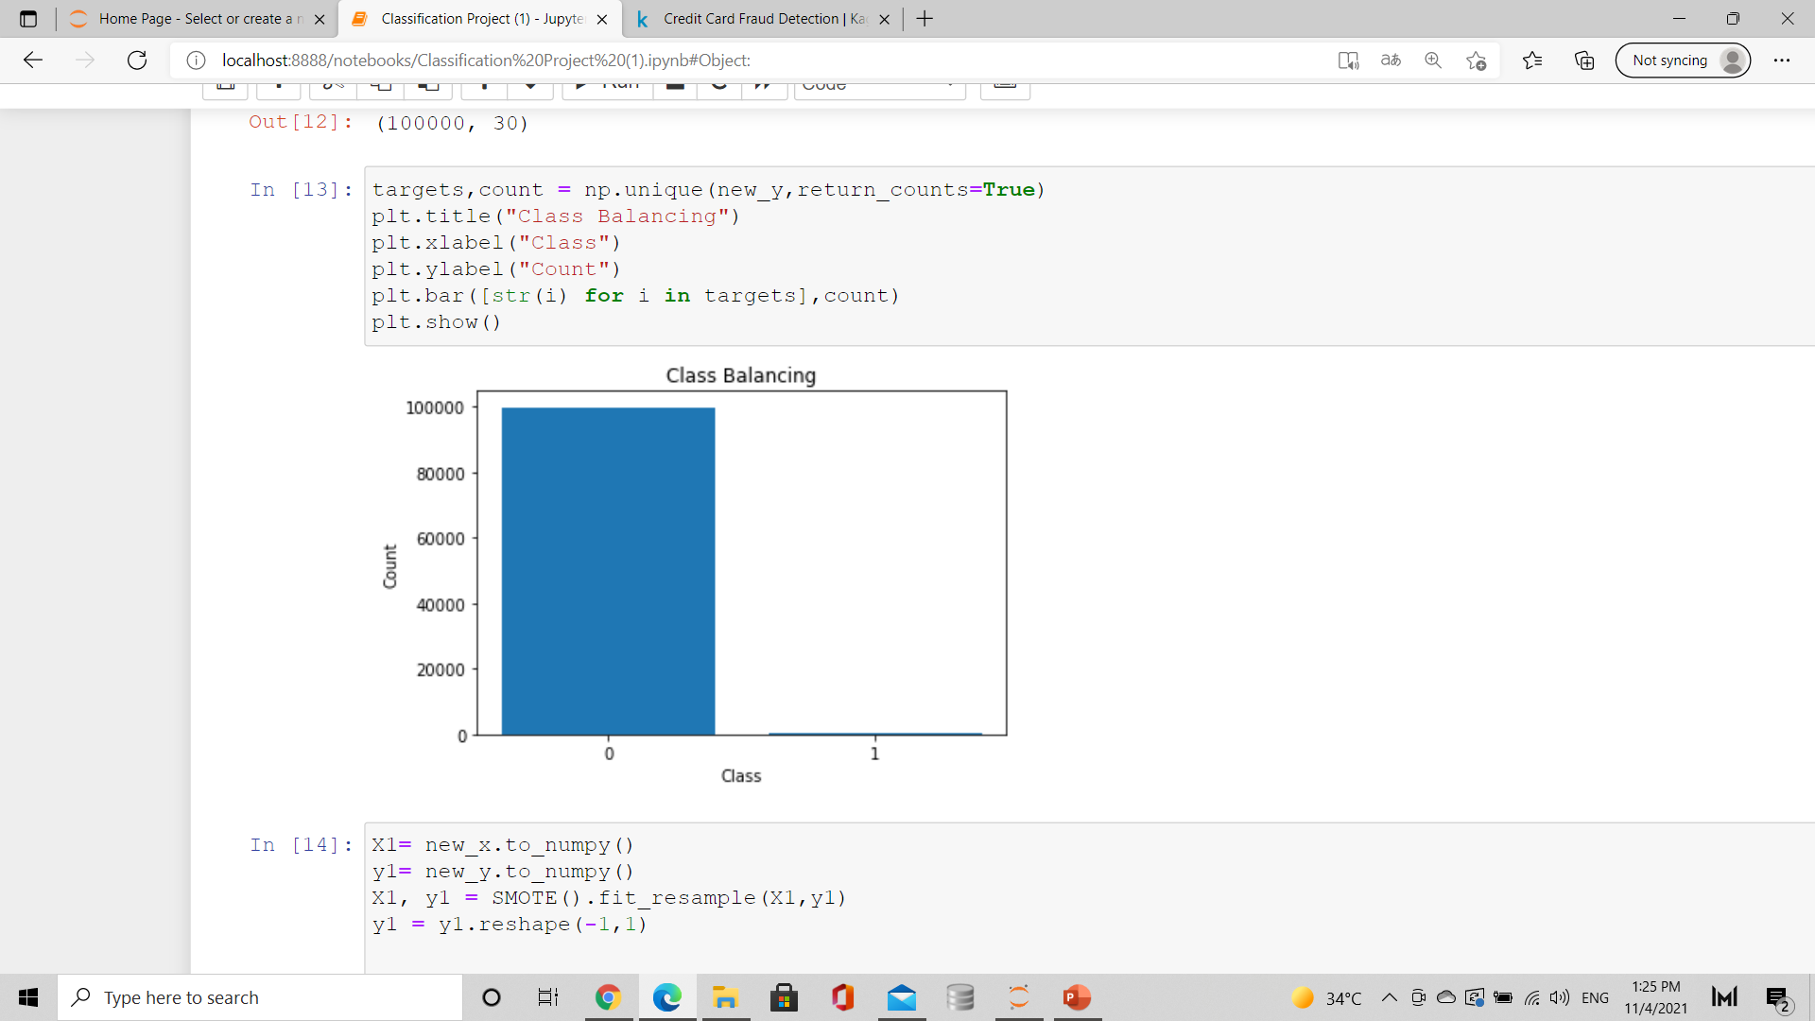
Binary Calssification
0
1
Genuine (Negative)
Fraud (Positive)
99839 genuine
161 fraud case
Imbalanced classes!

Slide 4
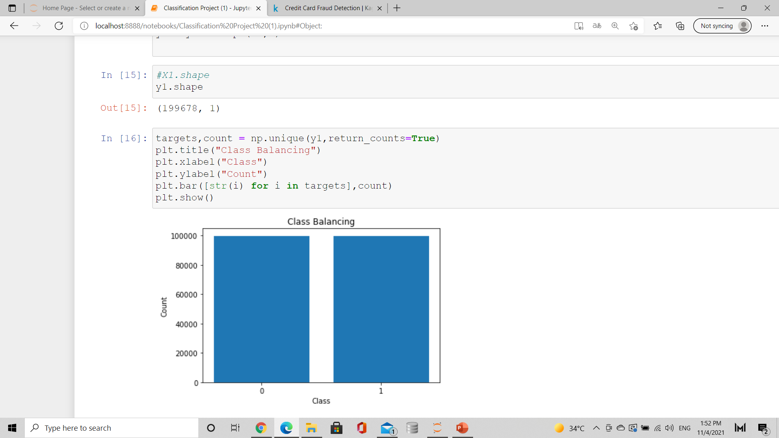
To manage imbalanced classes:
Synthetic Minority Oversampling Technique ( SMOTE ).

Slide 5


Classification Models:
Logistic Regression
Random Forest
0.9804
0.9997
KNN
Decision Trees
0.9279
0.9998

Slide 6
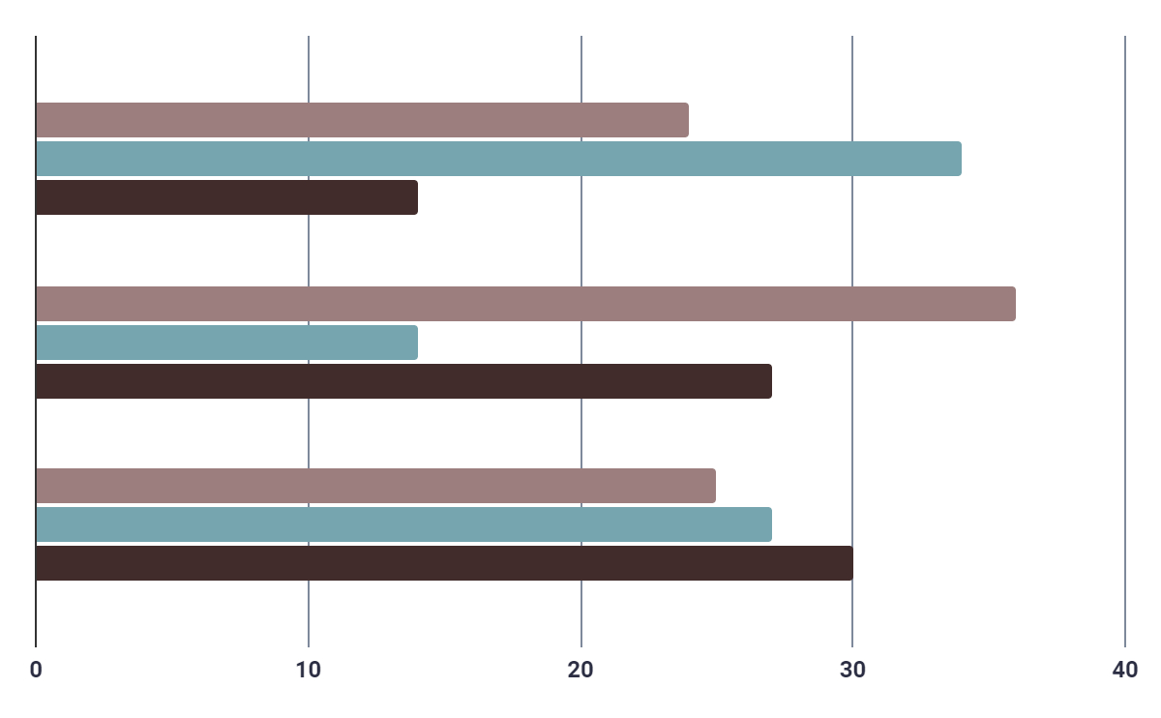
Voting Classifier:
Soft score
0.9996
Hard score
0.9982

Slide 7
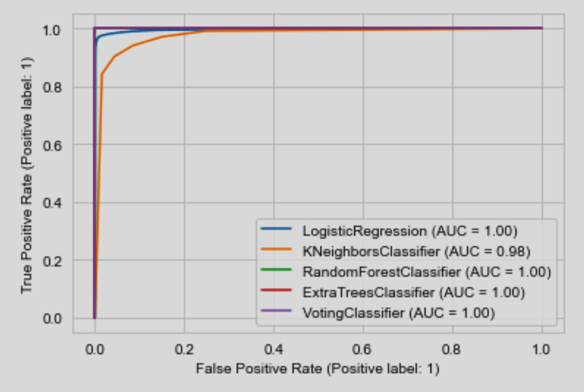
ROC/AUC Curve

Slide 8
THANK YOU

